Slide 1
ONLINE BUS TICKET RESERVATION SYSTEM
CMT 400 : Research Project
Name : PETER SILA KIOKO| REG. Num: 1040449
Supervisor: CHRIS NANDASABA

Slide 2
Background of the research
The "Bus Ticket Reservation System" is an innovative web application designed to address bus ticketing problems.
Traditionally, bus ticket reservations were primarily managed through manual processes.
This approach posed numerous challenges, including limited accessibility, long queues, and a lack of real-time information.
The "Bus Ticket Reservation System" is an innovative web application designed to address these challenges.
Additionally, it streamlines booking processes, offering features for cancellations, modifications, and providing up-to-the-minute information on bus availability and schedules.

Slide 3
Problem statement
In the traditional methods of bus ticket reservation and management present a series of challenges and inefficiencies.
The reliance on manual processes, paper-based tickets, and in-person transactions has limited accessibility.
Lack of Real-Time Information: Passengers often face difficulties obtaining real-time information on bus schedules, availability.
Operational Challenges: For bus operators, manual ticketing processes are labor-intensive and prone to human errors.

Slide 4
Main Objective
To provide flexibility to customers since booking can be done without travelling to the booking office.
Provide a user friendly bus ticket booking facility on the web so customers can get bus tickets through the online system without having to queue at the offices.

Slide 5
Specific objectives
To Assess the Implementation of the "Bus Ticket Reservation System“.
To Examine the Impact of the Online Booking System on Passengers.
To Identify Areas for Further Enhancement.
To Contribute to the Advancement of the Bus Transport Sector.

Slide 6
Analysis: Requirements analysis
Functional requirements
The system will perform the following functions:
Capture user details during registration.
Enable users and admins to log in.
Allow users to search for available bus routes.
Enable users to book tickets.
Generate reports of bookings and transactions for the admin.
Allow the admin to create, edit and delete bus information.
Allow the admin to create, edit, or delete user accounts.
Enable users to view their bookings history.

Slide 7
Analysis: Requirements analysis
Non-functional requirements
These requirements portray the goals the system aims to achieve.
Security The system will ensure secure access to confidential data by restricting access to unauthorized personnel
Portability The system should be flexible to run on new platforms without requiring code changes.
Reliability and Dependability The system will undergo testing to ensure it can perform its tasks without failures in the appropriate environment.
Fault Tolerance The system should be able to resist and recover from failures easily.
User-Friendliness The system will feature visible text and graphics, good color contrast, readable fonts, and easy navigation to accommodate first-time users.
Scalability The system will be designed to accommodate changing user requirements and accept modifications without failure.

Slide 8
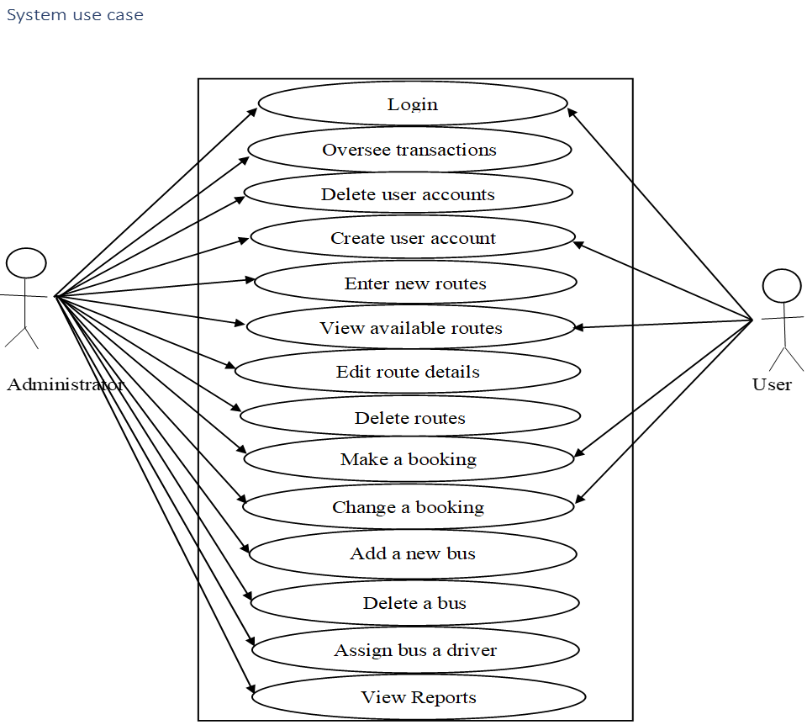
Analysis: System Analysis (Use Case Diagram )

Slide 9
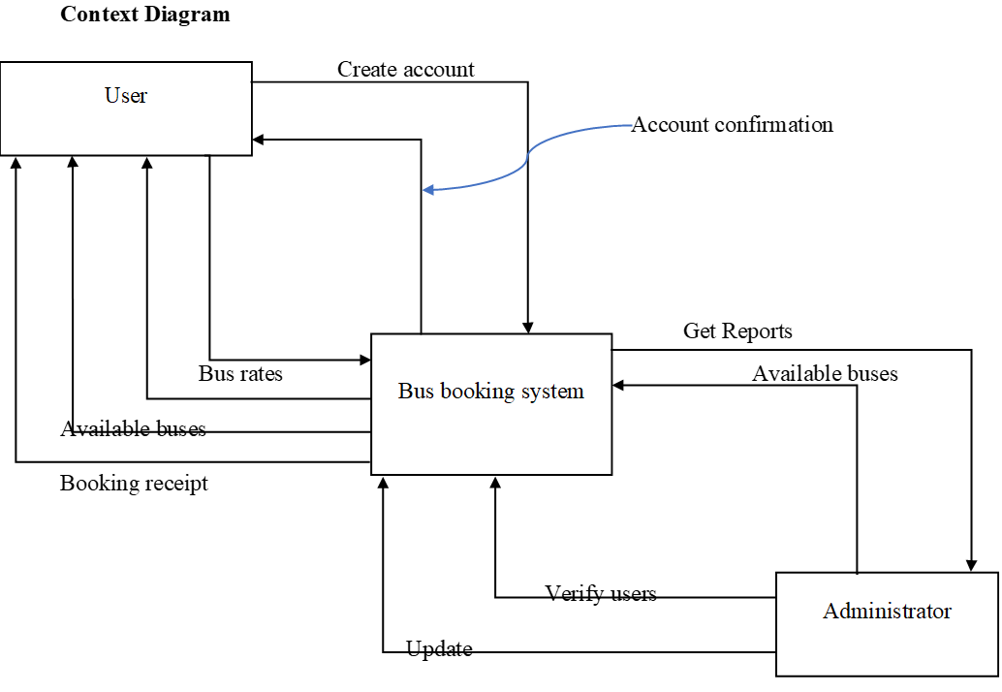
Analysis: System Analysis(Context Diagram)

Slide 10
Analysis(3)
System users/actors
Administrators
Passengers
System Input/ Input forms
User registration form
User login form
Forgot password form
Contact us form
Search schedule form
Add bus form
Edit bus form
Add driver form
Edit driver form

Slide 11
Analysis(3) Continuation
Add user form
Add bus form
Edit bus form
Add schedule form
Edit schedule form
Search booking form
Add user form
Search user form
Allocate driver a bus form
Add location form
Edit location form

Slide 12
Analysis(3) Continuation
System output/ Reports
Bus report based on status
Schedule report based on route
Booking report based on Payment status
Booking report based on schedule
User report based on role
Payment report based on Payment status
System Entities
User and Authentication entities – it can be an admin or a passenger
Location
Bus
Schedule
Booking
Payment
Driver

Slide 13
System Design: System Activity Diagram

Slide 14
System Design: System Sequence Diagram

Slide 15
System Design: Registration flow chart

Slide 16
System Design: login flowchart

Slide 17
System Design: logout flowchart

Slide 18
System Design: Context Diagram

Slide 19
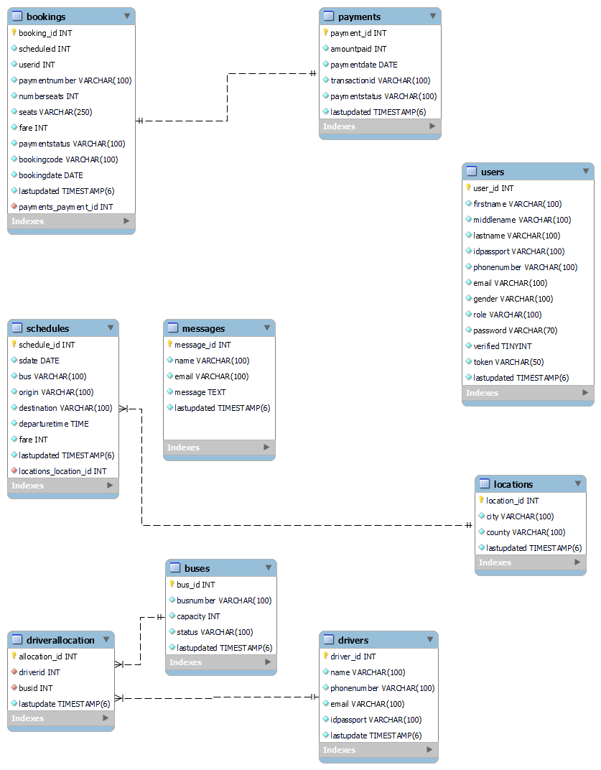
Design(2) : ER DIAGRAM

Slide 20
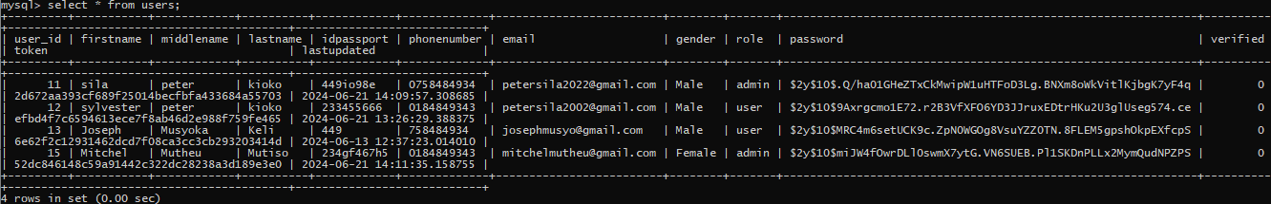
Design(3)
Test data

Slide 21
Implementation
Implemented user registration and login
Implemented user booking process
Implemented frontend and backend for all features
Implemented the admin dashboard

Slide 22
The End
Thank you
[proceed to your system /prototype presentation]

